Slide 1
MARKET BASKET ANALYSIS
Presenters names
1.Sai Teja Uppu
2.Shiva Sai Amaravadi
3.Hari Prasad Yedluri
4.M Manikanta Venkata

Slide 2
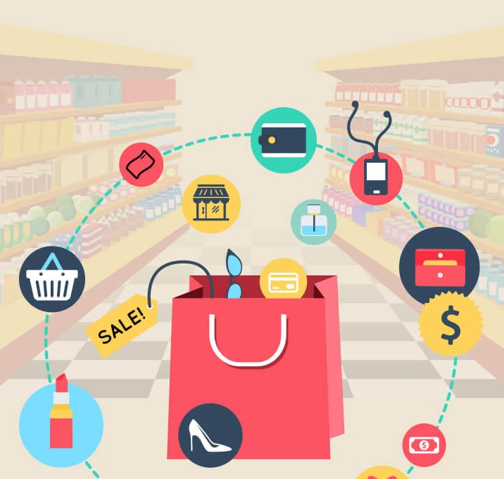
Agenda
Data Set
Exploratory Data Analysis
Detail Design of Features
Analysis
Implementations
Results

Slide 3
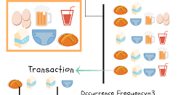
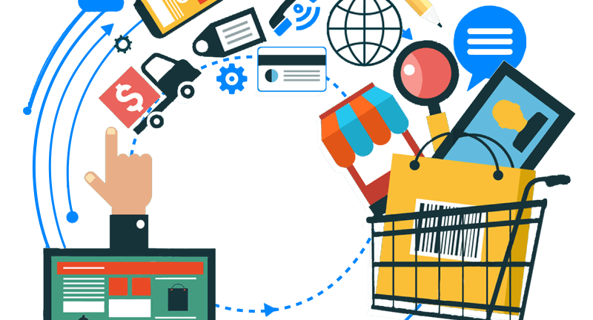
Data Set
. It works by understanding the relationship between frequently brought products and the transaction.
It helps business people understand which product is important and which people buy.
The data set consists of 38765 rows of purchases of customers from supermarket stores.
By history, we can analyse the data and association rules can be generated using the Market Basket Algorithm for example Aprioor algorithm

Slide 4
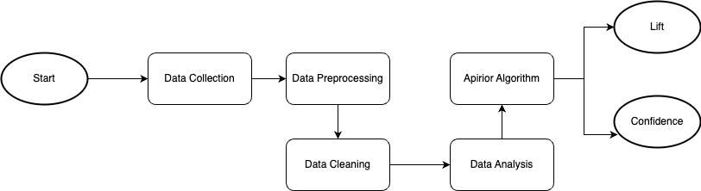
DATA FLOW DIAGRAM

Slide 5
EXPLORATORY DATA ANALYSIS(EDA):
1.Here, in this project we will be using exploratory data analysis technique to identify the trends in data of dataset which we take from Kaggle data set.
2.It generally involves to analyze and investigate data sets and to summarize their key characteristics.
3.In EDA we often use data visualization techniques, it helps us to manipulate data sources which is useful in identifying patterns outliers in data, also to test hypothesis for data.

Slide 6
Detail Design of Features
In total there are 38765 rows of translation data is there in the dataset. The dataset has 3 columns Member number, Date and Item Description.
The member number is a unique transaction number where each number represents the translation id. whereas the data is in day month and year format.
Item description has product details with space separated by next.
When data was collected from the famous Kaggle website which is very reliable and authentic source to collect data for the data science community.
The columns are represented in inte64 and object format. Where as date also represented in object format.
In a sequence of generating the features of our model date was converted into date format using famous python library called pandas.
members id are converted into string format becuase thery are uninqu in nature

Slide 7
Analysis
1. Stores use market basket analysis to figure out what people like to buy together. They look at a lot of receipts to see what products are often bought together. Then, they use this information to make decisions about how to stock their shelves and what discounts to offer.
2.This can help them sell more products and make more money. The customers-items matrix is a table that shows what products each customer has bought.
3.Each row in the table represents a different customer, and each column represents a different product. The numbers in the table show how many times each customer has bought each product. The most items that appeared together are butter and shopping bags and spread cheese.

Slide 8
IMPLEMENTATION
Apriori algorithm refers to an algorithm for computing association rules between objects. This shows how two or more things are related. In other words, we can say that the apriori algorithm is an inverse association rule that checks if people who bought product A also bought product B .
The main objective of the apriori algorithm is to establish association rules between objects. The association law describes how two or more entities are related to each other. Apriori algorithms are also known as frequent pattern mining.
Typically, you apply the Apriori algorithm to a database with many jobs. Let us understand the apriori algorithm with the help of an example; Imagine going to Big Bazaar to buy different things.
It helps consumers shop faster and increases the size of retail markets. In this tutorial, we will discuss the apriori algorithm with an example

Slide 9
IMPLEMENTATION
Apriori algorithm refers to the algorithm used in mining frequent product sets and related association rules. Generally, the apriori algorithm works on a database with a large number of transactions. For example, merchandise customers but in a Big Bazaar. The Apriori algorithm helps customers shop faster and increases the sales performance of a particular store.

Slide 10
CALCULATIONS
Support (Biscuits) = (Transactions relating biscuits) / (Total transactions)
= four hundred/4000 = 10 percentage.
Confidence refers to the opportunity that the clients offered each biscuits and candies collectively. So, you need to divide the variety of transactions that incorporate both biscuits and sweets with the aid of the entire wide variety of transactions to get the self belief.
Confidence = (Transactions relating both biscuits and Chocolate) / (Total transactions involving Biscuits)
= 200/400
= 50 percent.

Slide 11
CALCULATIONS
Consider the above example; raise refers back to the boom inside the ratio of the sale of sweets while you promote biscuits. The mathematical equations of lift are given below.
Lift = (Confidence (Biscuits - chocolates)/ (Support (Biscuits)
= 50/10
= 5

Slide 12
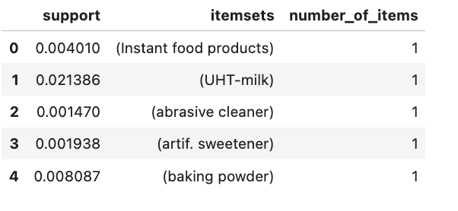
PRELIMINARY RESULTS

Slide 13
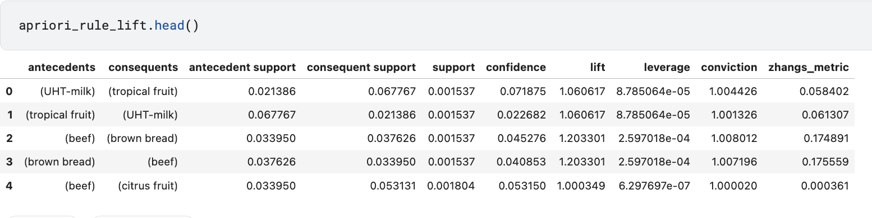
RESULTS

Slide 14
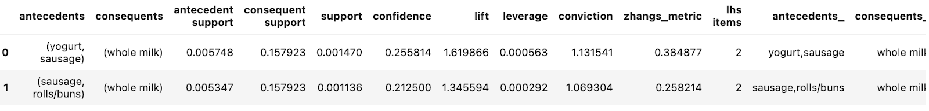
CONFIDENCE
How likely an item Y is purchased when an item X is purchased

Slide 15
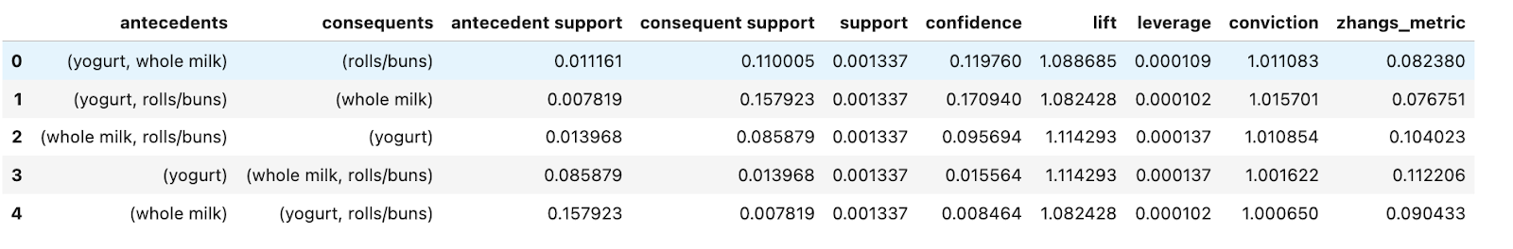
LIFT
Lift displays the ratio of confidence for the rule to the prior probability of having the rule prediction.
Lift value greater than 1 suggests that item Y is likely to be bought when item x is bought

Slide 16
TEAM ROLES
Task | Person | Status | Contribution
Data Cleaning | Sai Teja | completed | 25%
Analysis | Shiva Sai | completed | 25%
Analysis | Hariprasad | completed | 25%
Model Training | Manikanta | completed | 25%

Slide 17
Thank you

